Slide 1

INFORMATION HIDING
Scalable Image Coding
Adib Nikjou, Shiraz University of Technology, Summer 2025

Slide 2
Introduction to Scalable Coding

Slide 3
Traditional vs. New Generation compression
Traditional Image Coding Systems
➢ Focused on compression efficiency (main objective)
➢ DCT-based
➢ Non-Scalable
➢ Block (Frame)-based
New Generation of Image Coding Systems
➢ Compression efficiency
➢ DWT-based
➢ Scalable
➢ Object-based

Slide 4
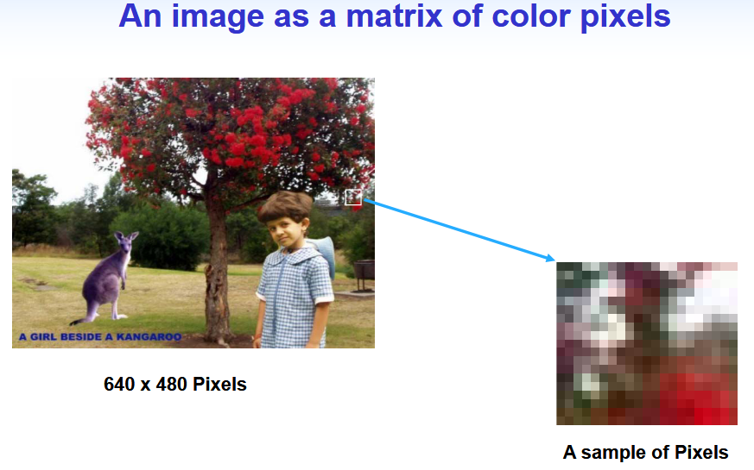
introduction

Slide 5
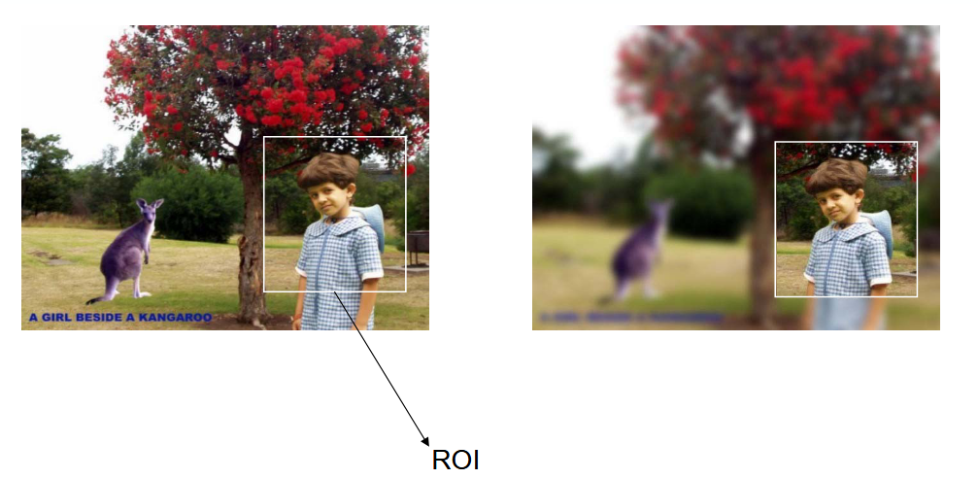

Region of interest (roi) coding

Slide 6
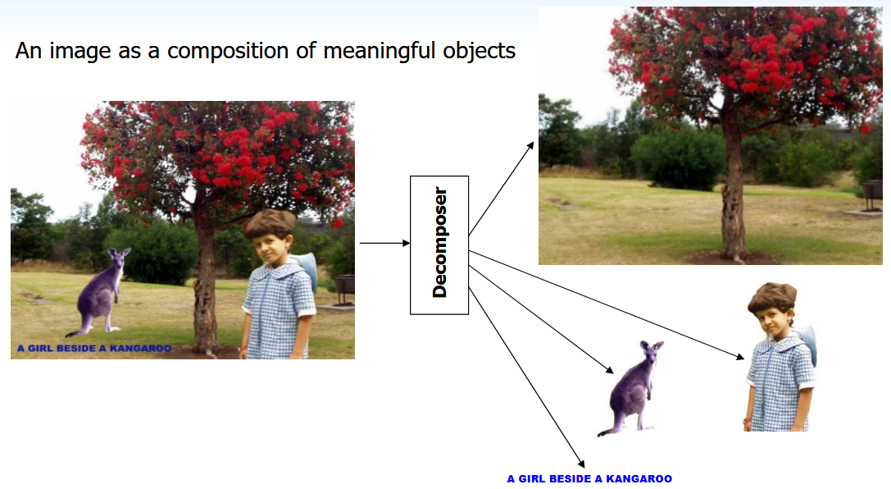
Object-based coding

Slide 7
What is Scalability?
Scalability refers to a potential in the coded bitstream, which allows a decoder to usefully decode from only parts of the bitstream in order to meet certain requirements.
A scalable bitstream consists of a set of embedded parts that offer increasingly better signal-to-noise ratio (SNR) and/or greater spatial resolution.

Slide 8
Why Scalable Image Coding?
Efficient storage and retrieval
Efficient transmission over heterogenous networks
- Progressive transmission such as progressive World Wide Web browsing
- Multicasting visual information
An important feature of the new generation of visual coding standards such as MPEG-4

Slide 9
Why Scalable Image Coding?
In today's digital age, the speed at which a website loads is crucial. A slow-loading website can lead to higher bounce rates, lower user engagement, and can negatively impact your site’s SEO rankings. One of the main culprits of slow loading times is the use of large, unoptimized images.

Slide 10
Why Scalable Image Coding?
🌐 Network & Storage Efficiency
Progressive transmission - Quality improves as more data arrives
Heterogeneous network support - Adapt to varying bandwidths
Efficient multicasting - Encode once, decode at multiple rates
Reduced storage redundancy - Single bitstream for all resolutions
🏥 Critical Applications
Medical imaging - MRI/CT scans with diagnostic-quality zoom
Progressive web browsing - Fast initial display, detail on demand
Visual transmission - Adapt to client capabilities automatically
Image databases - Efficient storage and retrieval systems

Slide 11
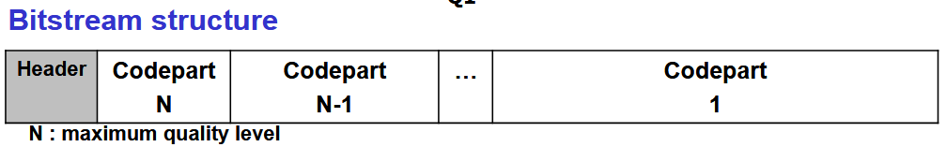

Why Scalable Image Coding?
📈 Technical Advantages
Embedded bitstreams - Can stop decoding at any point
Rate-distortion optimization - Best quality for given bit budget
Object-based support - Focus encoding on regions of interest

Slide 12
Scalability types
• Signal-to-Noise Ratio (SNR) scalability (Quality Scalability)
• Spatial scalability (Resolution Scalability)
• Frame-rate scalability (for video case)
• Combined Scalability

Slide 13
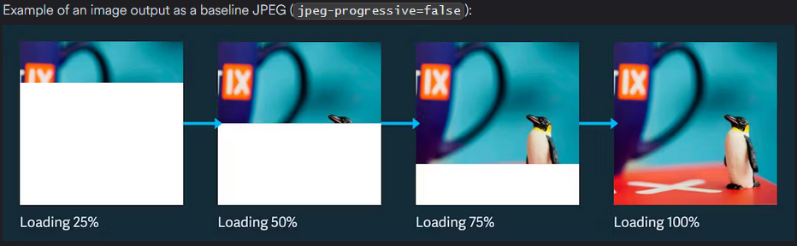
BASELINE (SEQUENTIAL) JPEG
NOT SCALABLE

Slide 14
Scalability types
Progressive JPEG
• Signal-to-Noise Ratio (SNR) scalability (Quality Scalability)
• Spatial scalability (Resolution Scalability)
• Frame-rate scalability (for video case)
• Combined Scalability

Slide 15
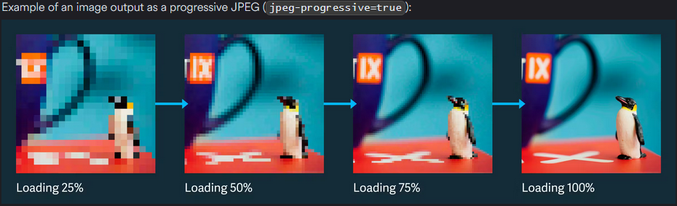
Snr (quality) Scalability

Slide 16
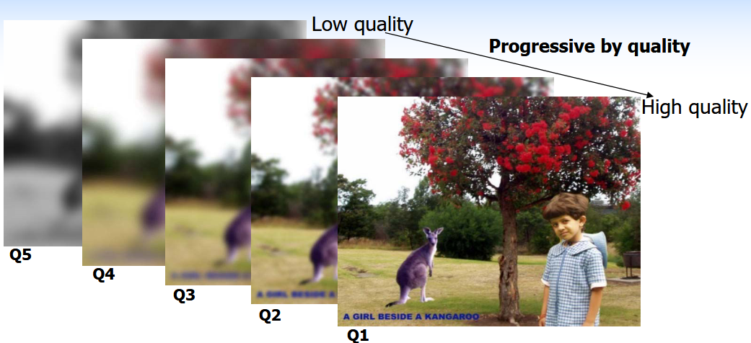
Snr (quality) Scalability

Slide 17
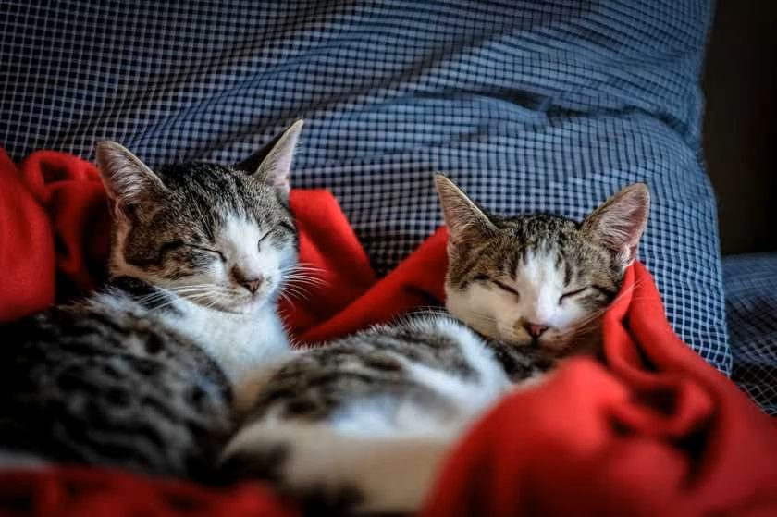
Snr (quality) Scalability

Slide 18
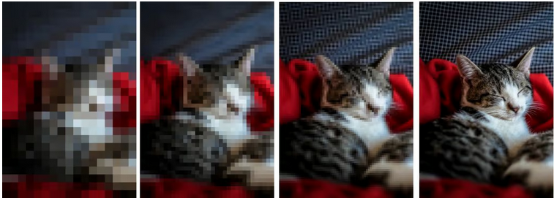
Snr (quality) Scalability

Slide 19
Scalability types
Hierarchical JPEG
• Signal-to-Noise Ratio (SNR) scalability (Quality Scalability)
• Spatial scalability (Resolution Scalability)
• Frame-rate scalability (for video case)
• Combined Scalability

Slide 20
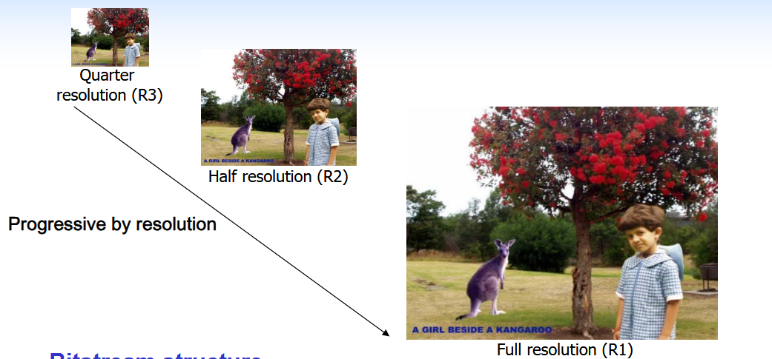
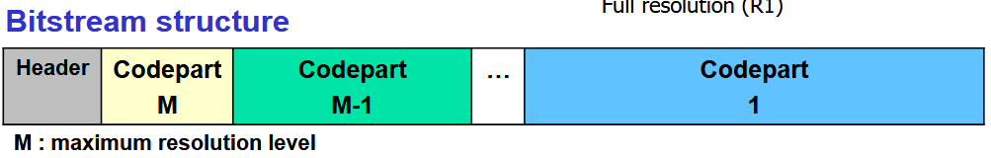
Resolution Scalability

Slide 21
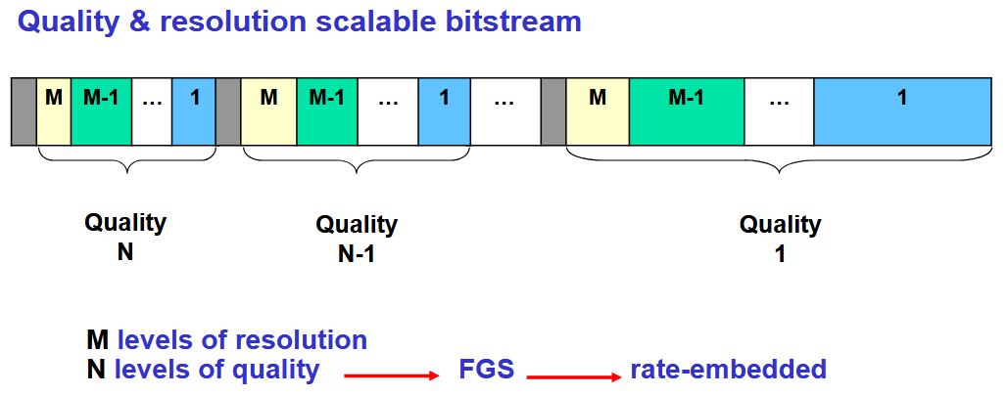

combined Scalability

Slide 22
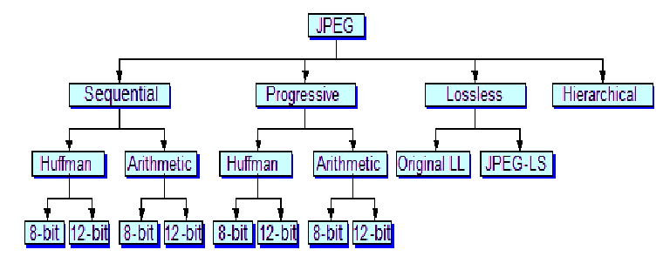
JPEG OPERATING MODES
Quality Scalability
Resolution Scalability
NOT SCALABLE

Slide 23
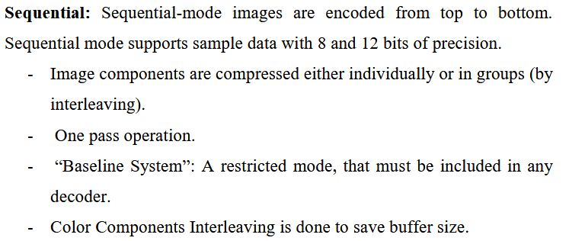
SEQUENTIAL JPEG MODE ( Most common )

Slide 24
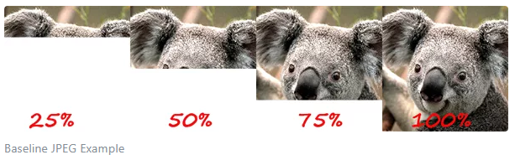
SEQUENTIAL JPEG MODE ( Most common )

Slide 25
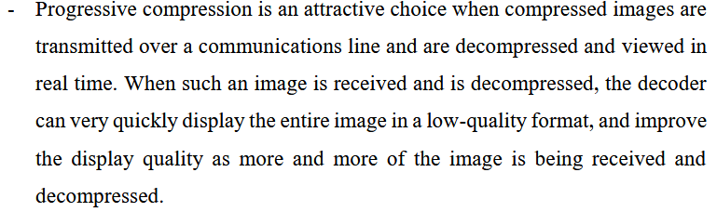
Progressive JPEG MODE

Slide 26
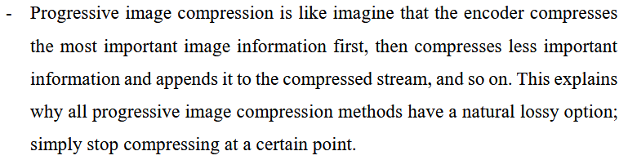
Progressive JPEG MODE

Slide 27
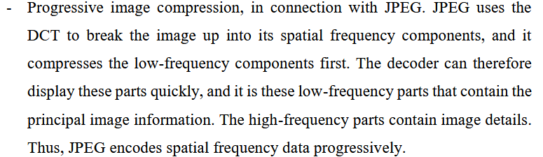
Progressive JPEG MODE

Slide 28
Progressive JPEG MODE
In progressive JPEG images, components are encoded in multiple scans.
A sequence of “scans”, each codes a part of the quantized DCT coefficients data.
Two ways of doing that:
- Spectral Selection
- Successive Approximation

Slide 29
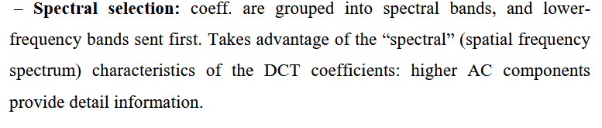
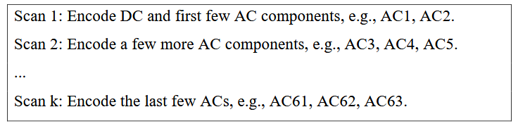
Progressive JPEG MODE

Slide 30
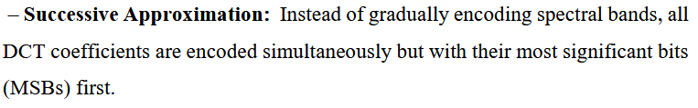
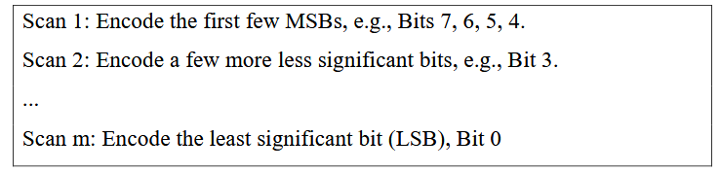
Progressive JPEG MODE

Slide 31
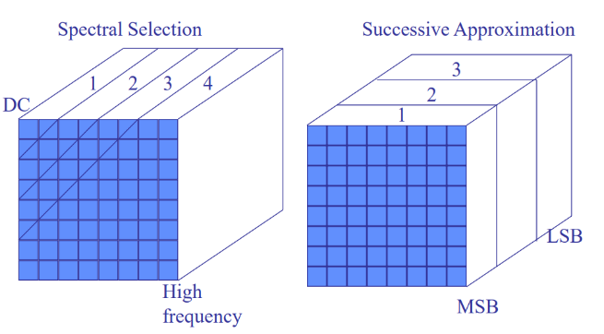
Progressive JPEG MODE

Slide 32
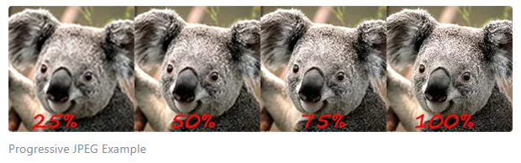
Progressive JPEG MODE

Slide 33
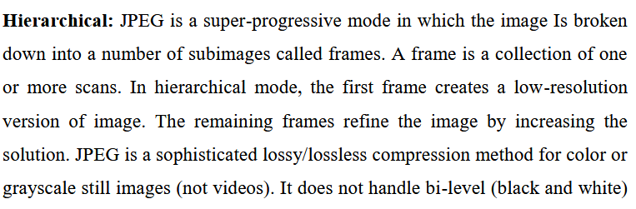
Hierarchical JPEG MODE
It is NOT JPEG2000

Slide 34
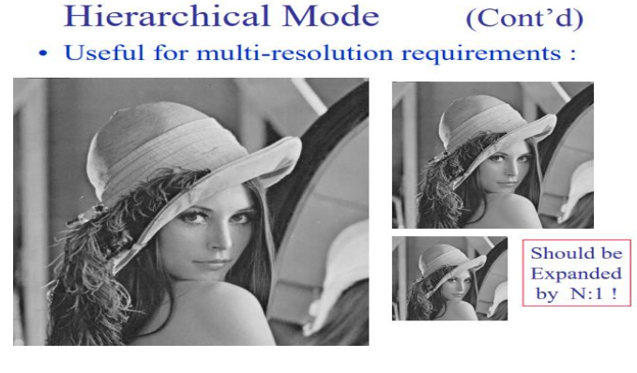
Hierarchical JPEG Mode

Slide 35
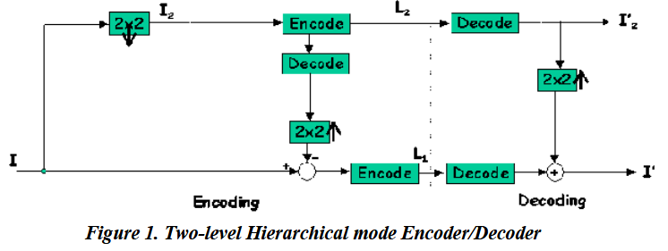
Hierarchical JPEG
We’re Only Down Sampling the Image
We’re Not Using Wavelet to do so ….

Slide 36
Hierarchical JPEG mode
Hierarchical JPEG is built on the same foundation as all other "classic" JPEGs:
The Discrete Cosine Transform (DCT).
It works by breaking the image into 8x8 pixel blocks and applying the DCT to each block. This is why all classic JPEGs, including Hierarchical, can suffer from "blocking"—visible squares in the image—at high compression.
Hierarchical mode creates a multi-resolution file by downscaling the image, encoding the small version, then upscaling it and encoding the difference for the next level up.

Slide 37
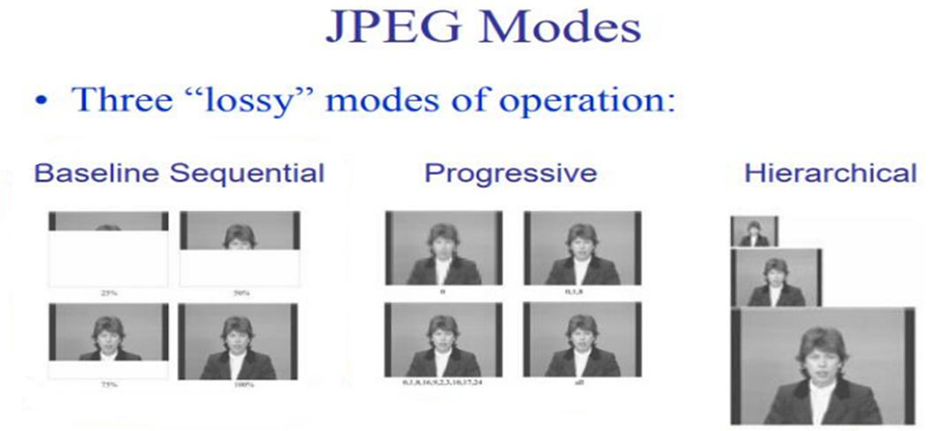
Lossy JPEG modes overview

Slide 38
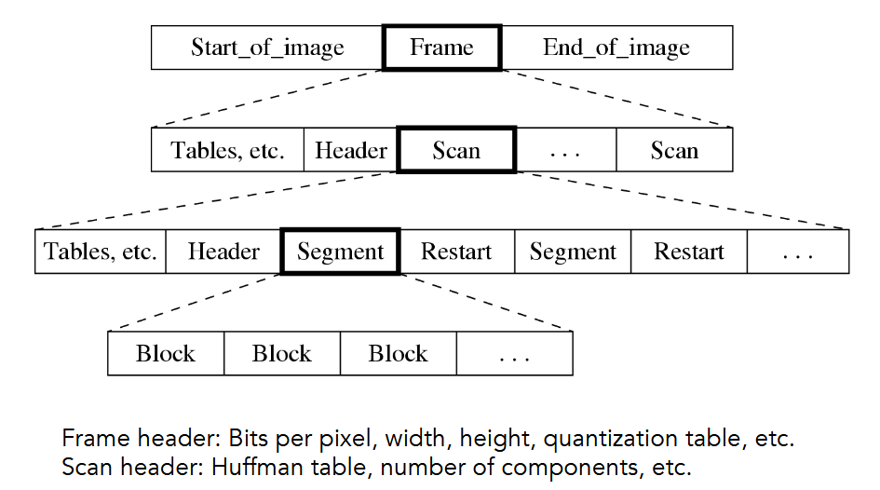
Jpeg bitstream

Slide 39
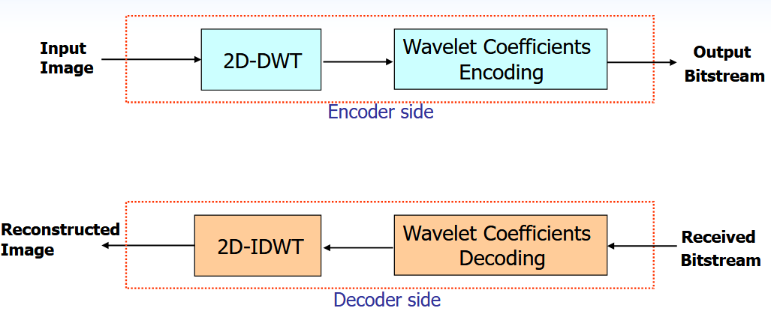
Wavelet-based image coding system

Slide 40
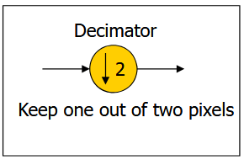
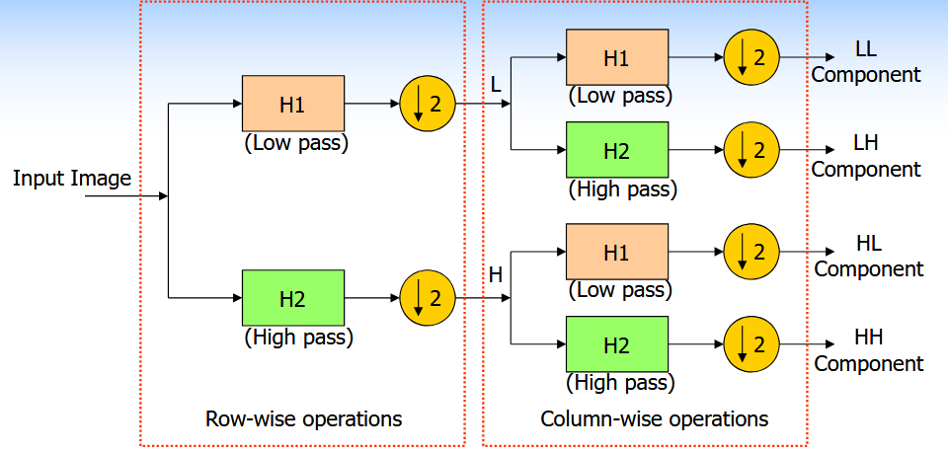
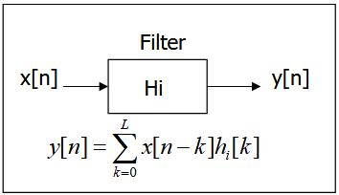
2-d discrete wavelet transform

Slide 41
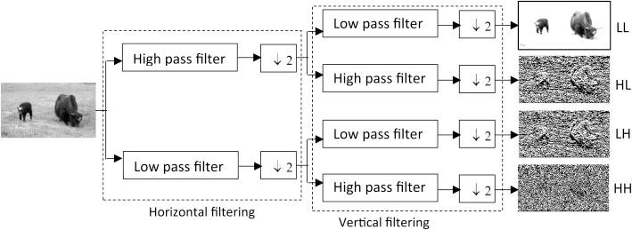
2-d discrete wavelet transform

Slide 42
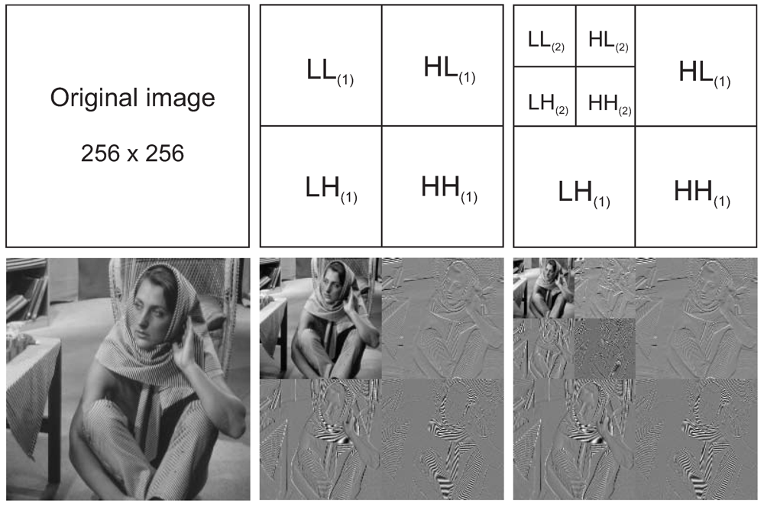
2-d discrete wavelet transform

Slide 43

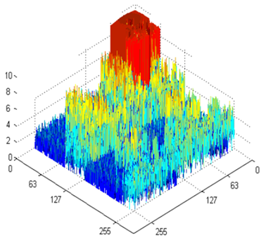
Set Partitioning in Hierarchical Trees (SPIHT)
Introduced by A. Said and W. A. Pearlman, in 1996
(an improved version of EZW, Shapiro, 1993)
KEY IDEAS
• Ordered bit plane coding
• Exploitation of self-similarity across wavelet scales
• Multi-pass zero-tree coding of wavelet coefficients
• Using individual lists for managing wavelet coefficients and sets

Slide 44
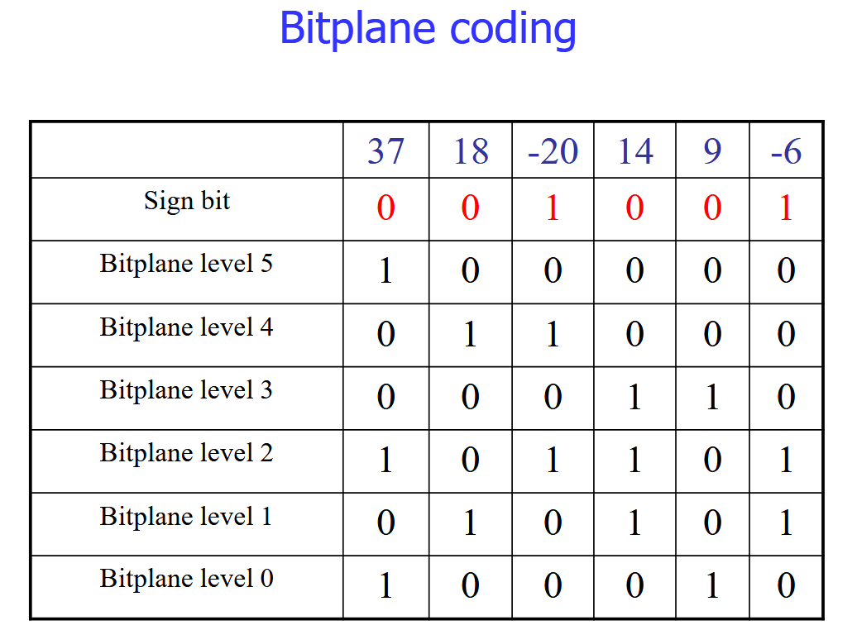

Slide 45
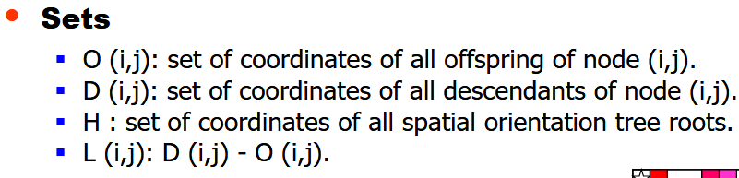
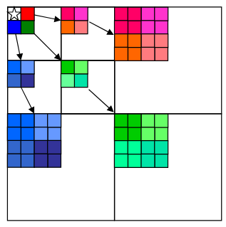
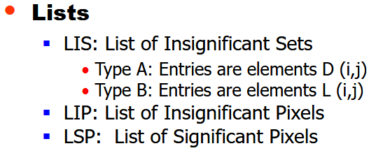
Set Partitioning in Hierarchical Trees (SPIHT)

Slide 46
Set Partitioning in Hierarchical Trees (SPIHT)

Slide 47
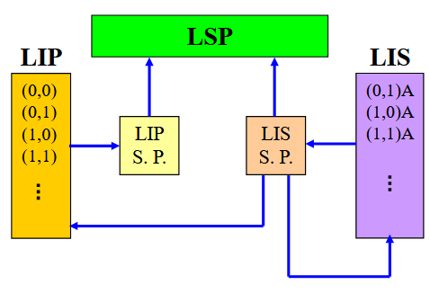
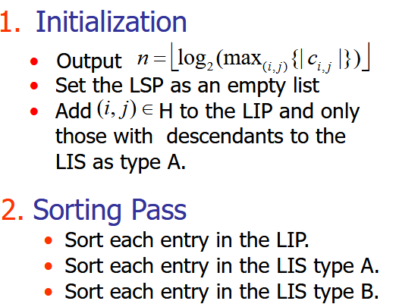
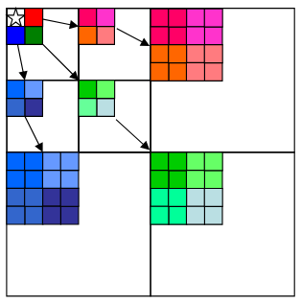
SPIHT Algorithm

Slide 48
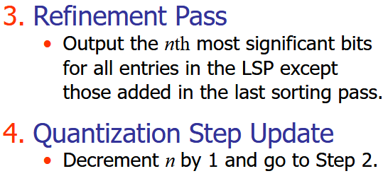

SPIHT Algorithm

Slide 49
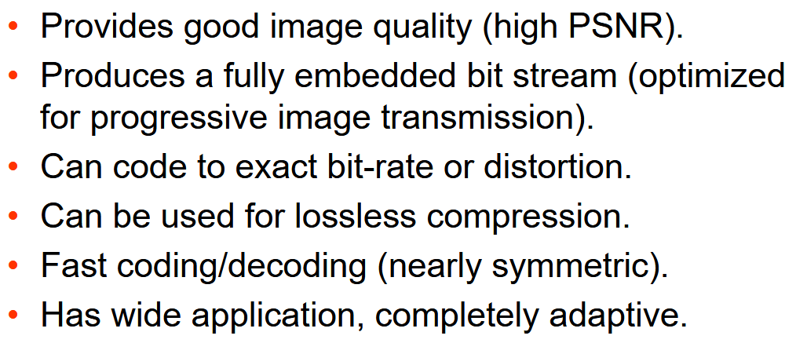

SPIHT Properties

Slide 50
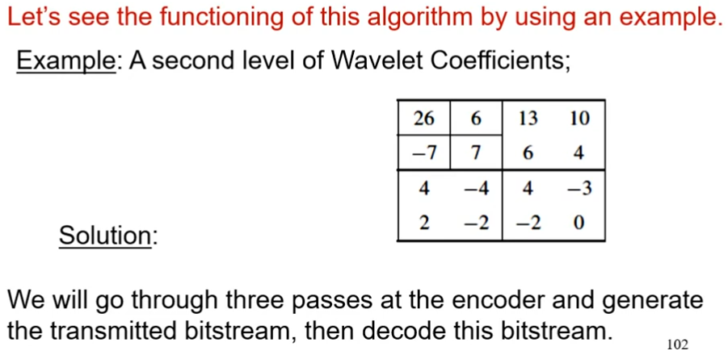
SPIHT algorithm detailed with an example

Slide 51
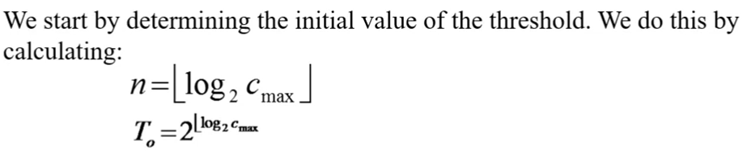
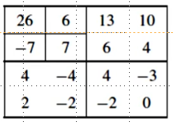
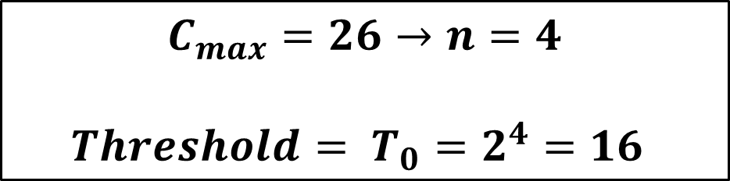
SPIHT algorithm detailed with an example
$$C_{max}=26→n=4$$
${Threshold= T}_{0}=2^{4}=16$

Slide 52
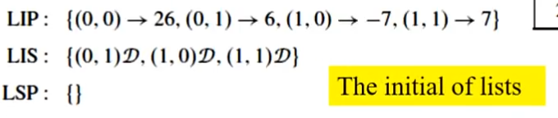

SPIHT algorithm detailed with an example
0 1 2 3
Initially contains all coefficients in the LL sub band (top-left 2×2)
0 1 2 3

Slide 53

SPIHT algorithm detailed with an example
0 1 2 3
Initially contains the coordinates of coefficients in LL that have descendants (children in other sub bands)
0 1 2 3

Slide 54
SPIHT algorithm detailed with an example
0 1 2 3
Initially empty: LSP = { }
0 1 2 3

Slide 55

SPIHT algorithm detailed with an example
FIRST PASS
0 1 2 3
SP = Significant Pixel
IP = Insignificant Pixel
SS = Significant Set
IS = Insignificant Set
We’re Comparing the Coefficients to the threshold which is 16 in this example.
0 1 2 3

Slide 56

SPIHT algorithm detailed with an example
FIRST PASS
0 1 2 3
0 1 2 3

Slide 57







SPIHT algorithm detailed with an example
SECOND PASS
0 1 2 3
0 1 2 3
7}
SS=1, Because of 13 and 10
Because of 6 and 4 in the set

Slide 58

SPIHT algorithm detailed with an example
SECOND PASS
0 1 2 3
Since LSP is no longer empty we have to do a Refinement PASS
0 1 2 3
Here we had threshold equal to 8, We do calculate the Mid Point and then compare it to the LSP which was 26 .
Mid Point = Prev Threshold + Threshold = 16 + 8 = 24
26 > 24 so SF equals to 1

Slide 59
SPIHT algorithm detailed with an example
SECOND PASS
0 1 2 3
A coefficient C has a value of 26. (LSP)
In an early pass, the threshold T is 16. The encoder tests if |C| >= 16. Yes, it is. It sends a "significant" bit (1) and a sign bit (+).
At this point, the decoder knows the value is significant and positive. It knows the value is somewhere in the range [16, 32). It doesn't know the exact value yet. This is the uncertainty interval. The decoder might use the midpoint, 24, for a preliminary reconstruction.
0 1 2 3

Slide 60


SPIHT bitstream
Bitstream [ Without the Header ] :
…
N=4
N=3

Slide 61

Fully scalable spiht (fs-spiht) - Objectives
1. Adding spatial scalability to SPIHT without sacrificing SNR scalability and compression efficiency.

Slide 62
Fully scalable spiht (fs-spiht) - Objectives
2. Easily parsable (reorderable) bitstream for providing different sub-bit streams according to the resolution and/or quality requested by a decoder.
Encoding spatial resolution sub-band sets separately by introducing:
➢ Individual lists for each level of spatial sub-band set
➢ Resolution- dependent sorting pass

Slide 63


Fully scalable spiht (fs-spiht)

Slide 64

Fully scalable spiht (fs-spiht)

Slide 65

Fully scalable spiht (fs-spiht) algorithm

Slide 66

Fully scalable spiht (fs-spiht) algorithm

Slide 67

Object-based fs-spiht (obfs-spiht)

Slide 68

Bitstream formation and parsing

Slide 69

Bitstream formation and parsing

Slide 70

multicasting
Encoding once, decoding multiple times at different rates (qualities) and resolutions

Slide 71

Some results and implementation details

Slide 72



Rate-Distortion results for different spatial resolutions of Goldhill image

Slide 73



Rate-Distortion results for different spatial resolutions of Barbara image

Slide 74

RESULTS (TIME SPENT BY FS-SPIHT DECODER)

Slide 75


RESULTS (FS-SPIHT)
(a) 0.125 bpp, Full Resolution [Left], Half Resolution [Middle], Quarter Resolution [Right]

Slide 76

RESULTS (FS-SPIHT)
(b) 0.25 bpp, Full Resolution [Left], Half Resolution [Middle], Quarter Resolution [Right]

Slide 77

RESULTS (FS-SPIHT)
(c) 0.5 bpp, Full Resolution [Left], Half Resolution [Middle], Quarter Resolution [Right]

Slide 78

RESULTS (FS-SPIHT)
PSNR results for foreground object of Akiyo still image (the first frame of MPEG-4 CIF Akiyo sequence) at different spatial resolutions and bit rates.

Slide 79


RESULTS - 3d obFS-SPIHT

Slide 80


RESULTS - 3d obFS-SPIHT

Slide 81

RESULTS - 3d obFS-SPIHT

Slide 82

conclusions

Slide 83

conclusions

